Slide 1
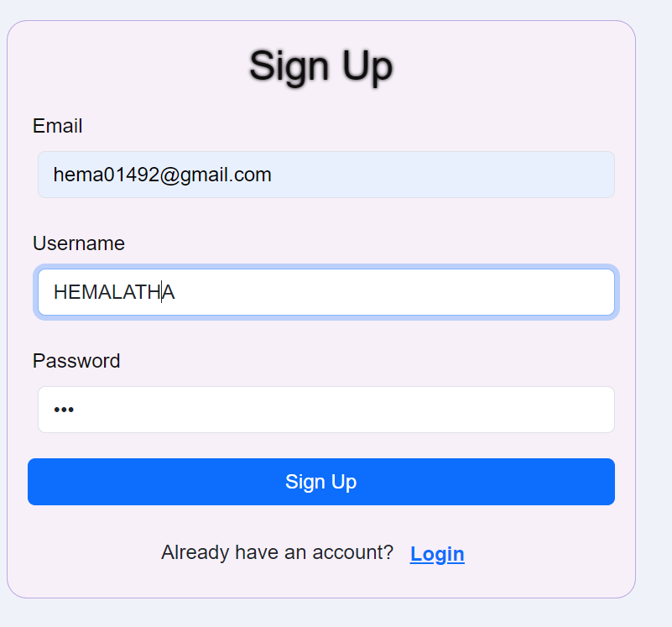
Enter email,username,password →CLICK Sign Up Button

Slide 2
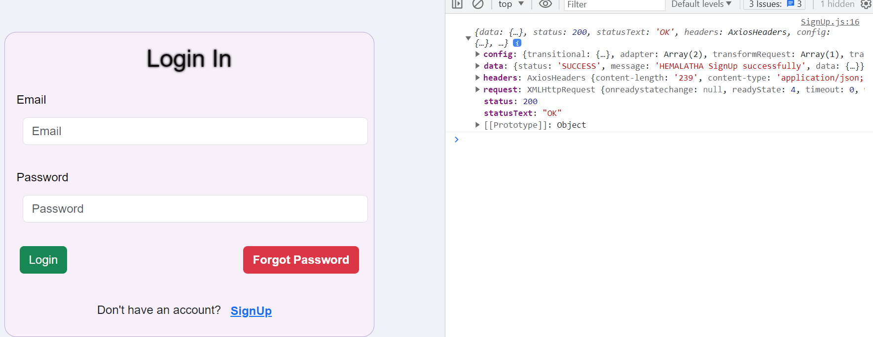
Sign up Clicked → Post the data to backend and Stored in Database → load Login Page

Slide 3
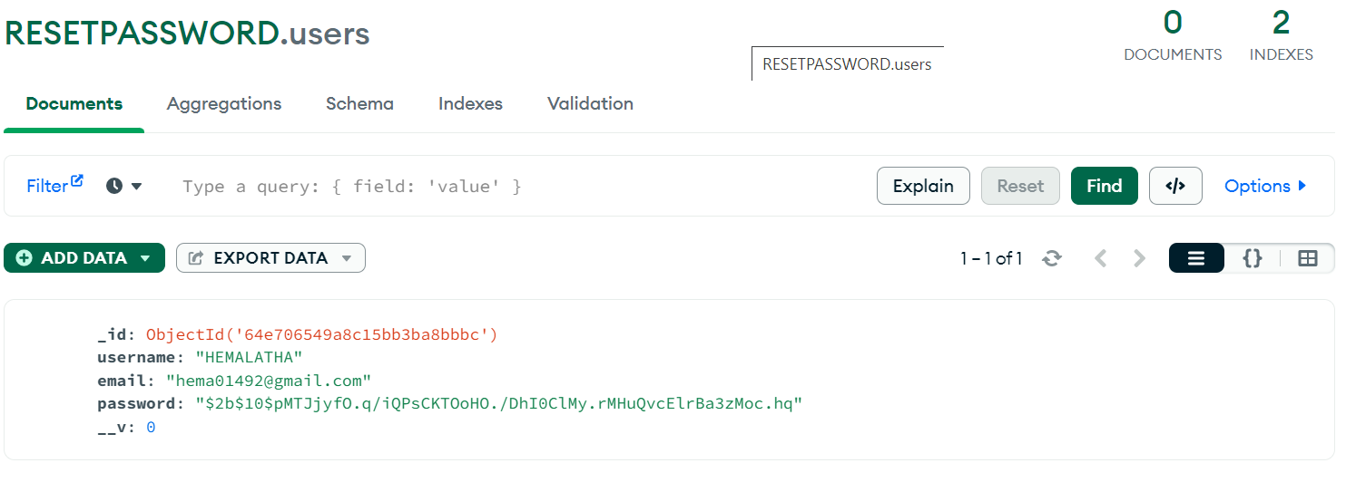
Data Stored in Database

Slide 4
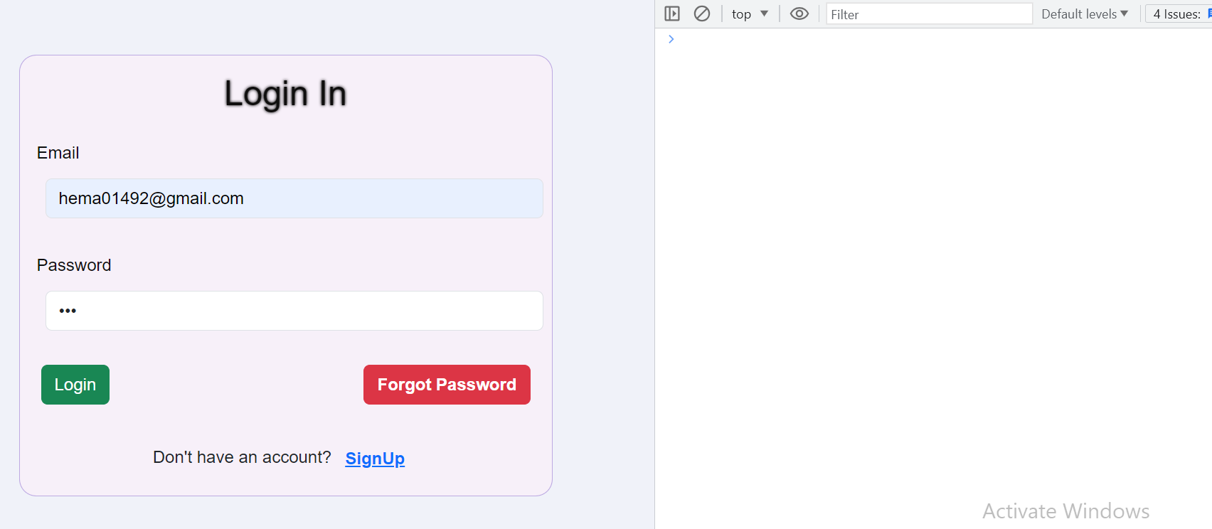
Enter email,password →CLICK Login in Button

Slide 5
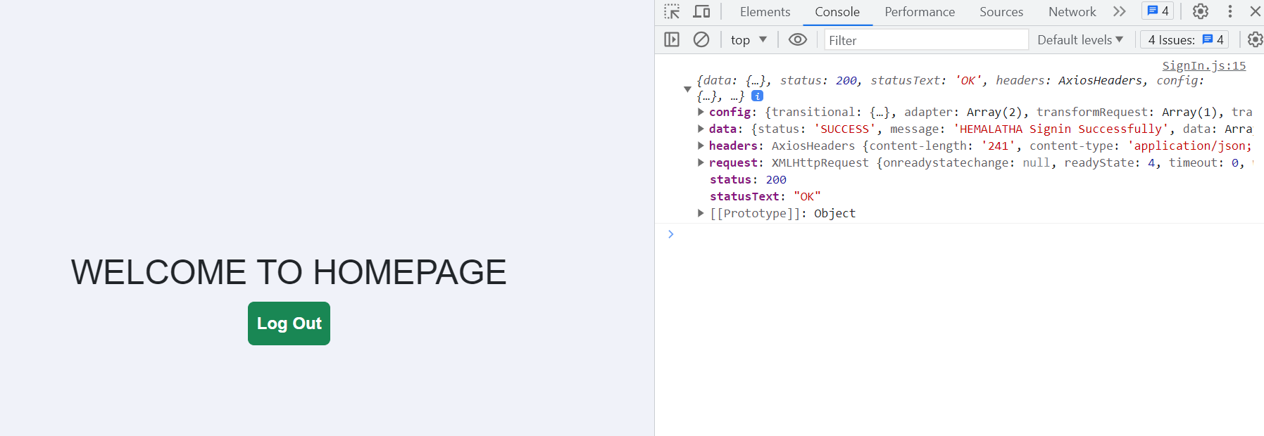
Login in Clicked → check data if user exist or not →if user exist → load Home Page

Slide 6
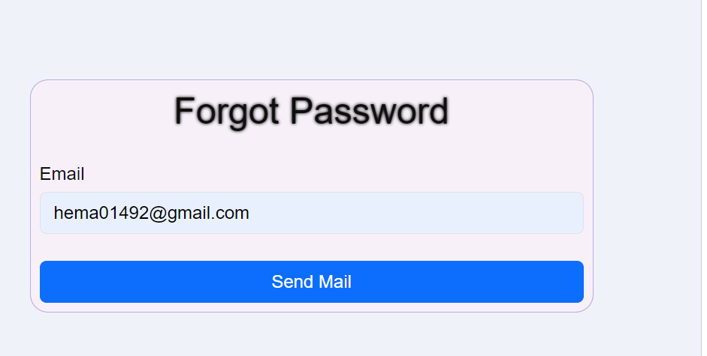
If Forgot Password Button Clicked→Load forgot Password page→enter email→click Send Mail

Slide 7
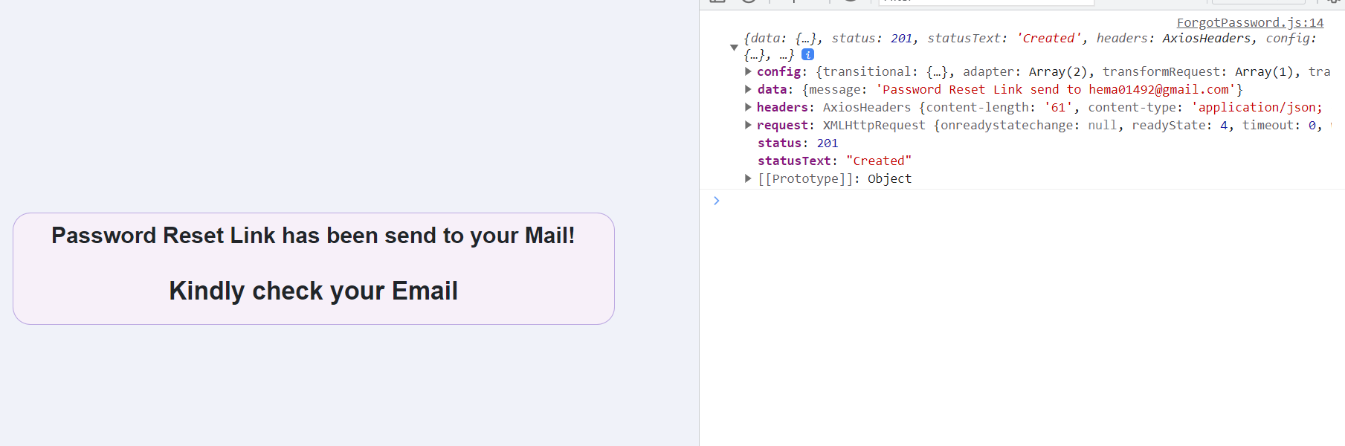
Clicked Send Mail button → load mail page and send email to the user

Slide 8
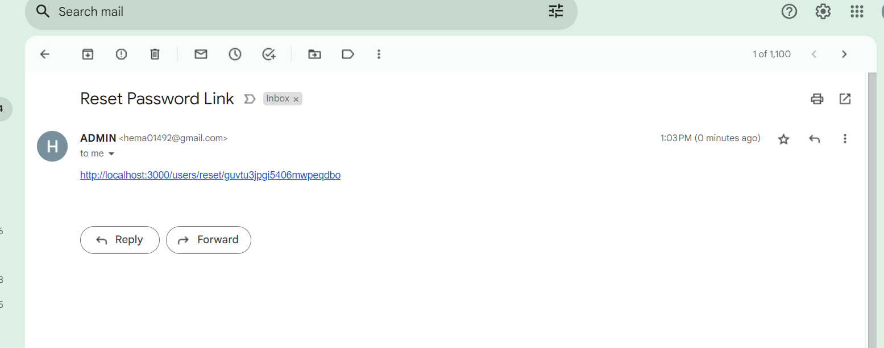
Receiving Reset Password Link

Slide 9
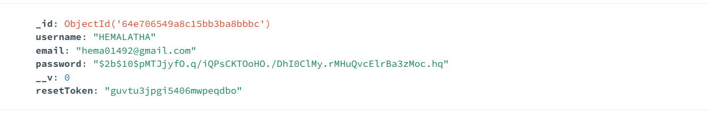
Random string stored as a resetToken in Database for verification

Slide 10
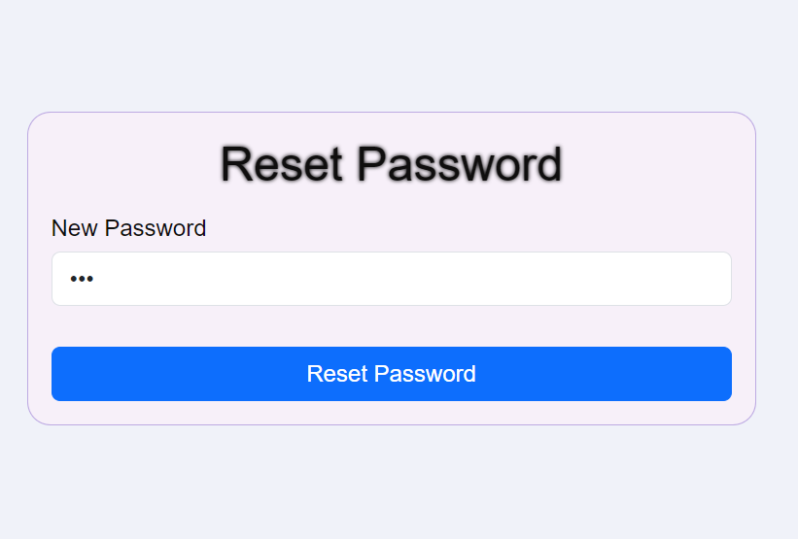
Click the mail link and enter NEW Password and click Reset Password

Slide 11
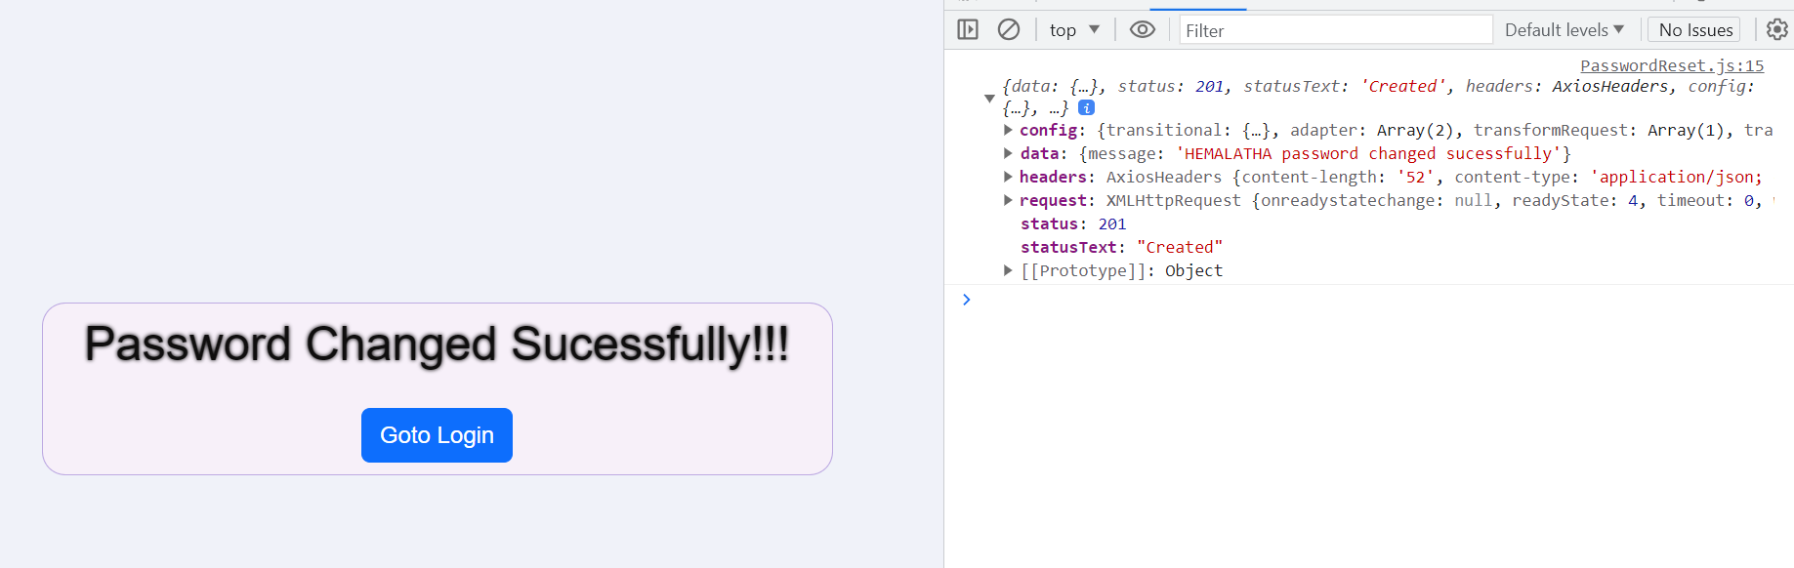
Password Changed

Slide 12
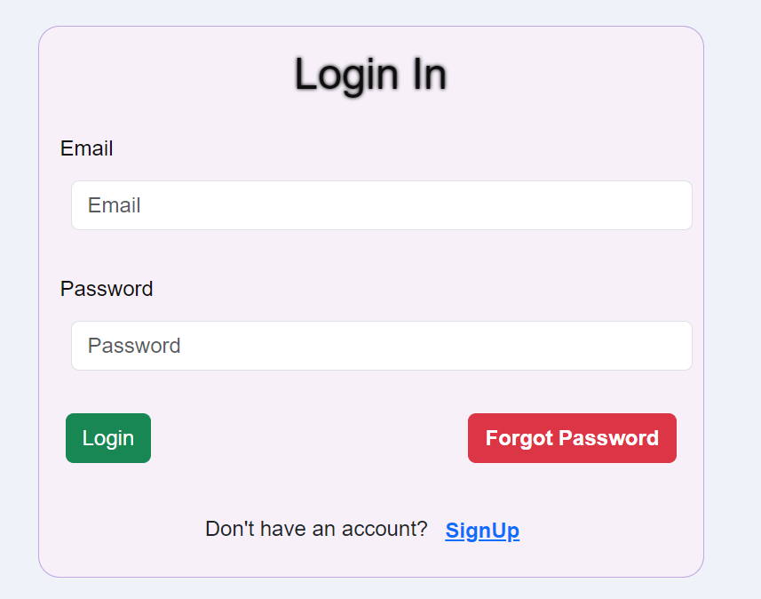
Clicked go to login page

